Slide 1
Sentiment & Keyword Based Amazon Review Text Generation
Blogpost: shorturl.at/ghuBR Github: shorturl.at/jEGT5
The Gradient Descenders: Alexander Berry, Jason Chan, Hyunjoon Lee, Sayan Samanta, Wanxin (Christina) Ye

Slide 2
Project Objective
Develop a Generative Model for topic-driven text generation.
More specifically, study the possibility of building a model that generates human-like texts while controlling the output based on user-defined context (by keyword and sentiment).
Notes:
This is Hyunjoon.
The objective of the current project was to develop a generative model for topic-driven text generation. More specifically, we studied the possibility of building a model that can generate human-like texts while controlling the content of the output based on user-defined context (keyword and sentiment).

Slide 3
Implication
Explore the feasibility of the use of plausible texts (articles, product reviews) to deceive the public to influence the market or product.
Notes:
This project is important because the fact that one can generate plausible (human-like) texts about a user-defined topic, with user-defined sentiment, opens door to numerous applications. For example, if a malicious user of these generative model can generate thousands of negative product reviews on Amazon to sabotage a product or generate positive product reviews to falsely promote their product that are plausible (human-like), this has a huge social implication. Through this project, we are exploring the feasibility of these application given the current state of technology.

Slide 4
Our Text Dataset
From Amazon Review Data (2018):
“Clothes, Shoes, and Jewelry” category.
Over 11 million reviews.
Review data contains ratings
Appropriate dataset for this project
Notes:
The large sample size as well as the availability of product ratings (substitute for sentiment) made the dataset appropriate for the objective of this project.

Slide 5
Overview
Baseline Model:
Fine-tuned GPT-2 Model
More Advanced Models:
Plug & Play Language Model (PPLM)
Conditional Transformer Language Model (CTRL)
Notes:
FINE TUNE
Christina is up next. Christina will start with presenting the dash app of our final product to give you a better idea of our project. And move onto exploratory data analysis.

Slide 6
Dash App and Exploratory Data Analysis

Slide 7
Exploratory Data Analysis
Preprocessing:
Shrink the data size
Create keywords using Spacy
Generate a feature ‘polarity’ to verify the sentiment of the text(rating)

Slide 8
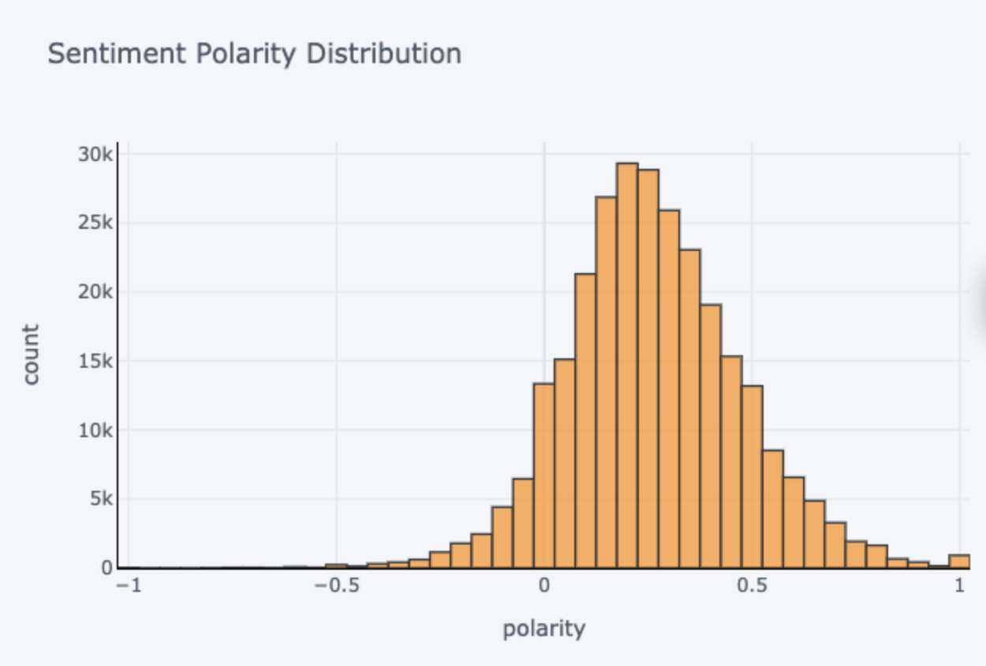
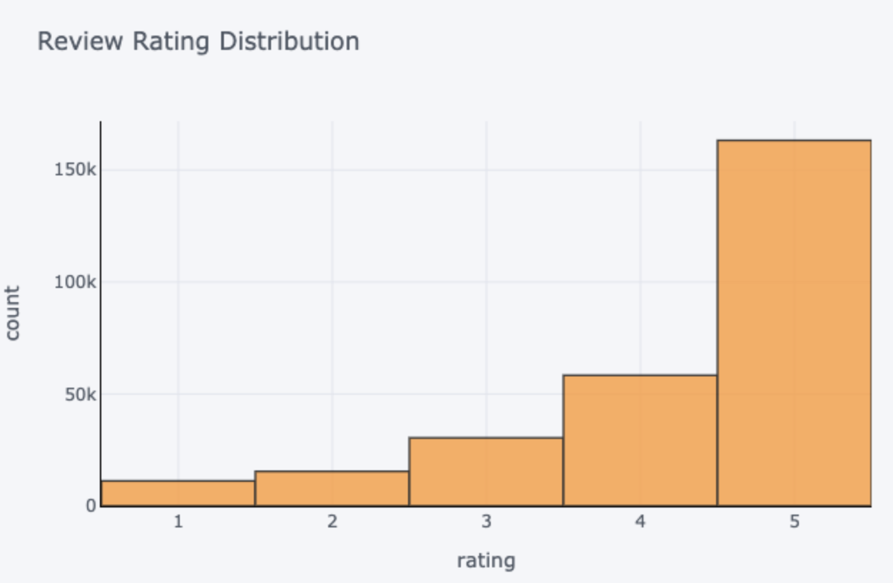
Exploratory Data Analysis
Sentiment distribution is mostly aligned

Slide 9
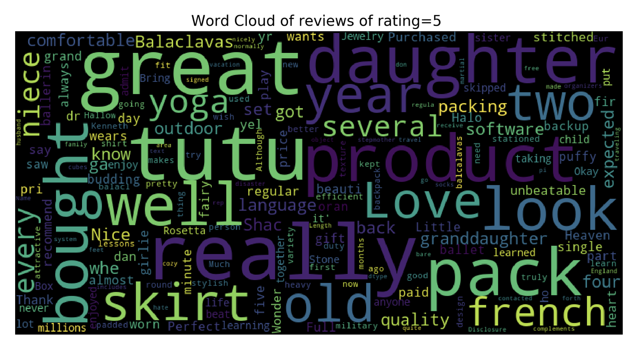
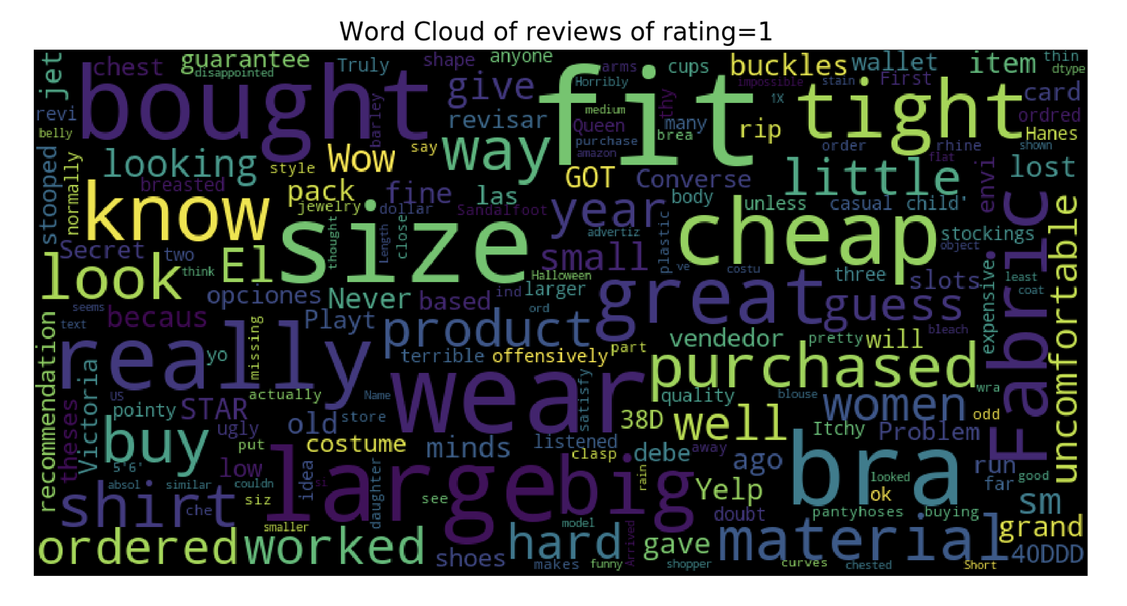
Exploratory Data Analysis

Slide 10
GPT-2: Keyword Based Generation

Slide 11
GPT-2 : Fine-tuning for keyword based text generation
Step 1: Generating keyword using Spacy and Ray
We look for the following POS:
Noun, Proper Noun - Raw
Adverb, Adjective and Verb - Lemmatised

Slide 12
GPT-2 : Fine-tuning for keyword based text generation
Step 2: Setting up the data file
Each entry is appended with certain tokens as follows:
<|startoftext|>~`5-0~^perfect a-hike~@Perfect hat for working … Great quality.<|endoftext|>
<|startoftext|> ⁠— indicating beginning of a sentence
~`n-0~ — Coarse conditioning (the review rating)
~^perfect a-hike~ — Fine conditioning (the exact words we would want in the review)
<|endoftext|> — A token to force short-form generation

Slide 13
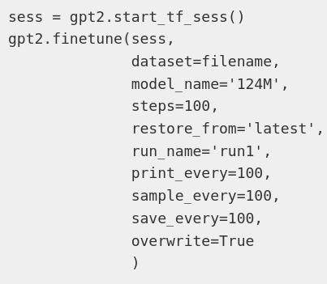
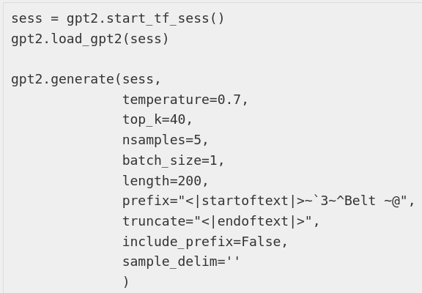
GPT-2 : Fine-tuning for keyword based text generation
Step 3: Fine-tuning
Step 4: Generate

Slide 14
GPT-2 : Fine-tuning for keyword based text generation
Rating: 1, Keyword: Belt
Very thin fabric. Material is super thin. Not much give in the waist. The belt is pretty thin. I am a size 6-8, and the 6-8 fit me perfectly. I wear a size 7 dress, but the 6-8 was too tight and the length was too short for me. I was really disappointed with the purchase.
Rating: 3, Keyword: Belt
purchased a belt with a buckle, which I thought was a nice addition. Unfortunately, the buckle broke. I had to glue it back together. If you have a small wrist, you might be able to use it, but if you have a larger wrist, you might not be able to use it.
Rating: 5, Keyword: Belt
Belt fit perfectly. Very happy with this purchase. Very comfortable. The fit is perfect.

Slide 15
PPLM: Sentiment Based Generation

Slide 16
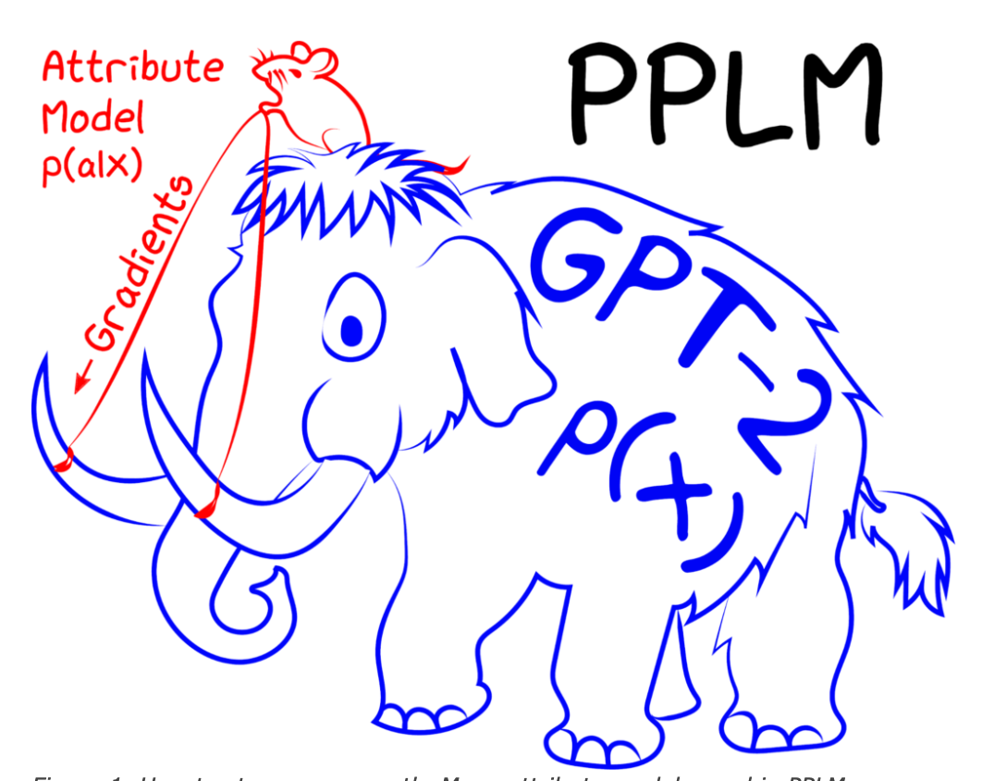
PPLM (Plug and Play Language Model)
“Steering A Mammoth”
Two Types of Attribute Models:
1. Bag of Words
Topic Representation
2. Simple Discriminators
Sentiment Representation

Slide 17
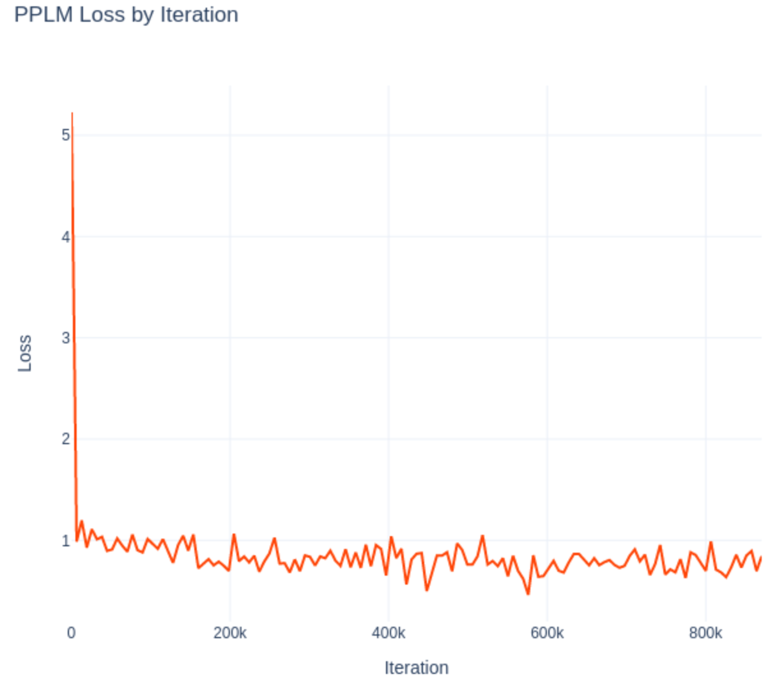
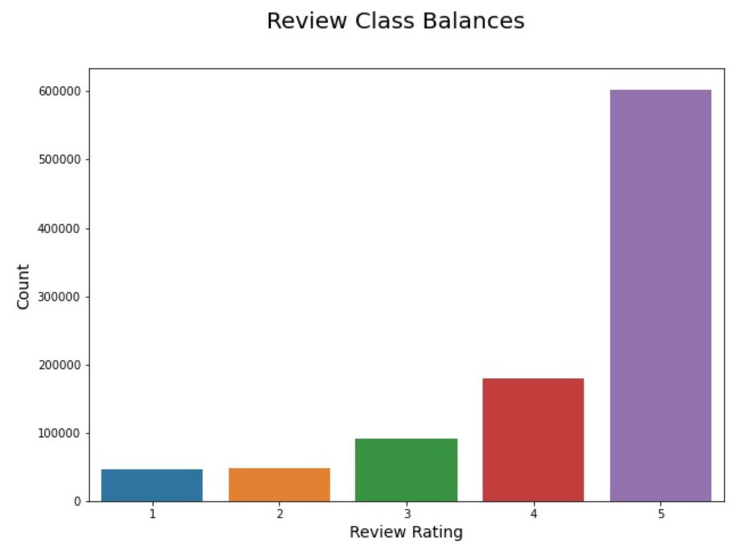
PPLM Training
Class Imbalance
Loss History

Slide 18
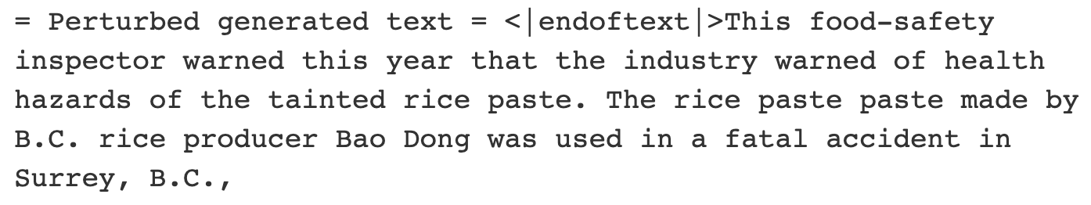
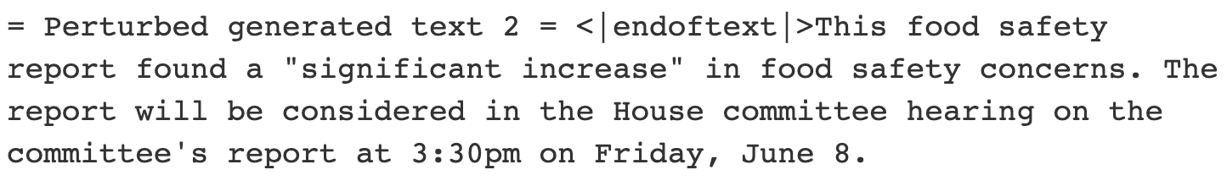
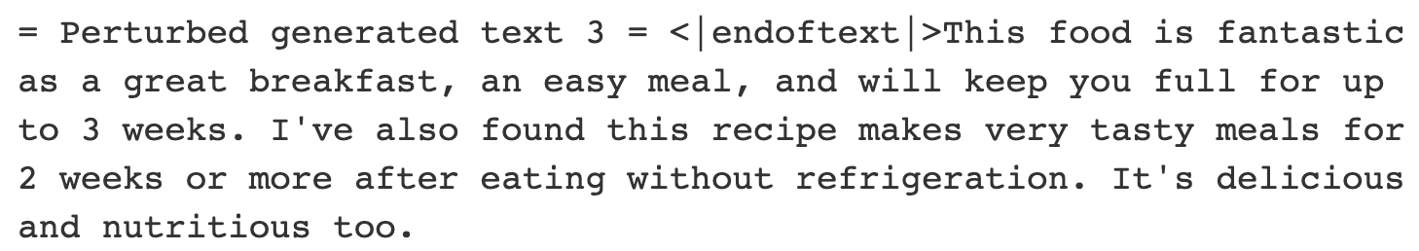
PPLM Results
Rating = 1
Rating = 3
Rating = 5

Slide 19
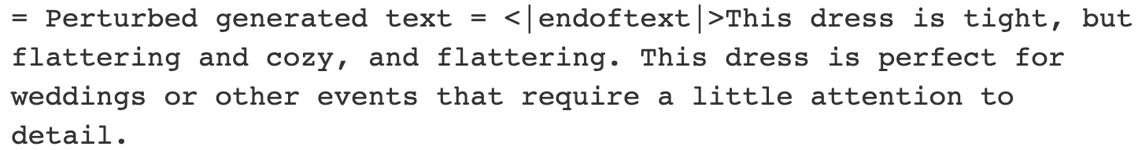
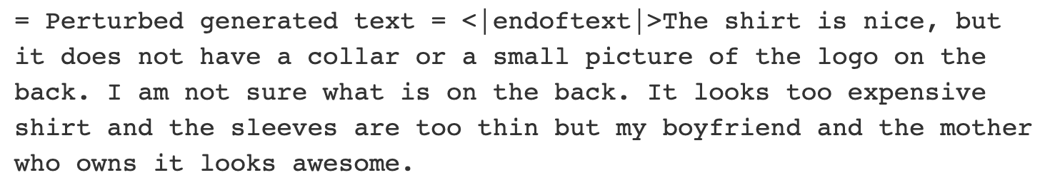
PPLM Results: Controlling Sentiment
Negative → Positive
Positive → Negative

Slide 20
CTRL:
Domain & Sentiment Based Generation

Slide 21
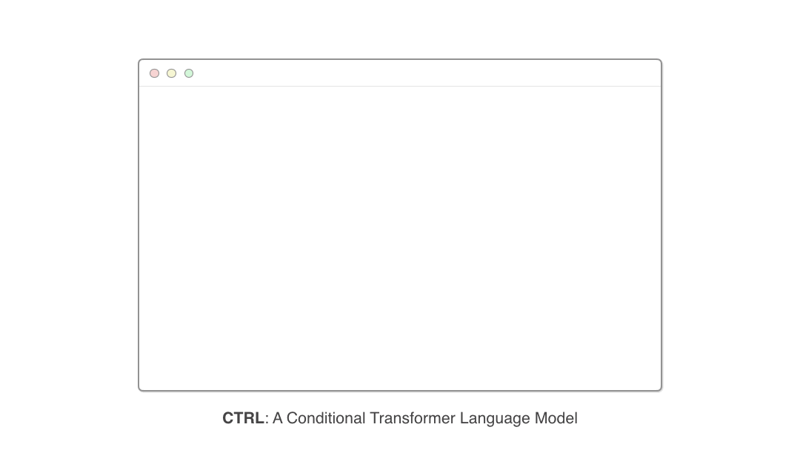
CTRL: Domain- and Sentiment-based Review Generation
1.6 billion-parameter language model with powerful and controllable artificial text generation
Control codes enable explicit influence over style, genre, entities, relationships between entities, and dates
Model is “less likely to generate random word sequences” than previous models.
Source: https://github.com/salesforce/ctrl
Notes:
This model is from Salesforce

Slide 22
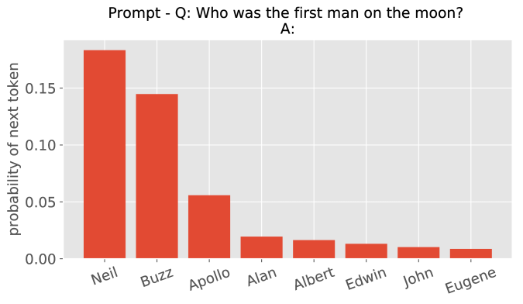
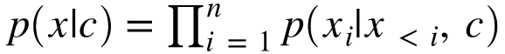
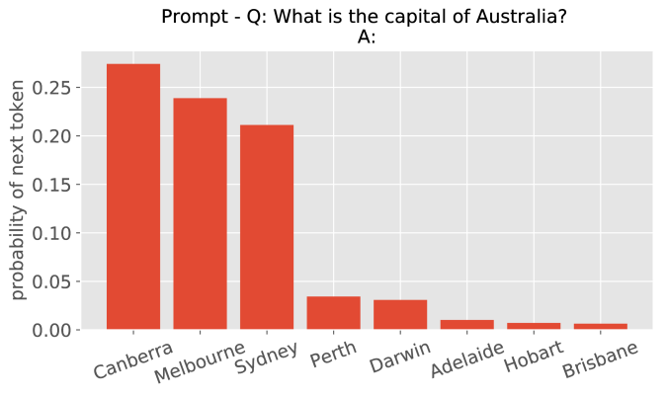
CTRL: Formulation
Goal:
Learn the conditional language model p(x|c) where c is the control code:
Sequentially sample from p(x) to generate tokens that make up the text.
Model penalizes samples that do not follow context of rest of sequence.
Source: groundai.com
Source: groundai.com
Notes:
Christina: MORE TIME FOR ALEX

Slide 23
CTRL: Generated Samples with Control Code “Reviews”
Rating: 1
This book is just another example of how to make money off of people who are gullible enough to believe in psychics. Rating: 1.0
I found this book to be poorly written and full of errors. Some sentences don't even make sense. Don't waste your time or money! Rating: 1.0
Not what I expected. Very short read. No real information provided. Would like more info on the subject. Rating: 1.0
Rating: 5
This item works as advertised. My wife uses it to listen to music on her phone while she works. Shes has had no problems with it, so far. Rating: 4.0.
Good quality sound from such small speakers. Easy to use and set up. Rating: 4.0
I love these. I can take them anywhere and put them wherever I want. And they don't cost much. Rating: 4.0
It is interesting to note that in the case of the Rating: 5 prompt, all of the generated reviews actually included ratings of 4.0. This might be due to an imbalanced lack of 5.0 ratings in the training set or just random variation.

Slide 24
Next Step
Combine the benefits of the 3 models.
GPT-2
→ Encode speech patterns, grammar, spelling
PPLM
→ No language model retraining required.
→ Stronger control over sentiment.
CTRL
→ Enforce the text to stay on topic.
Notes:
Thank you for listening.
Pplm doesn’t require language model retraining

